Slide 1
ITALIAN TOP GEARS SRL
ITG

Slide 2
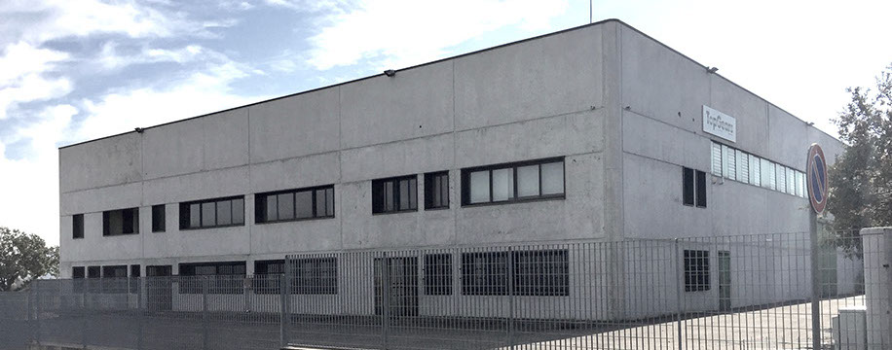
ITG Company Profile
2011 Founded
ISO9001 system certified company
Manufacturing location : Albinea (RE)

Slide 3
Corporate goal
WE BELIEVE THAT TO SUCCEED , OUR GOAL MUST BE TO STRIVE THRU EXCELLENCE & RELIABILITY TO CONTRIBUTE TO THE SUSTAINABILITY OF OUR ENVIRONMENT

Slide 4
CURRENT ITG GLOBAL SALES

Slide 5
Current day elevator environment
Increasing presence of Permanent Magnet technology
DRAWBACKS:
The dependence of the costs of the magnets, which is influenced by a neo-unique source of extraction : PRC. The magnets represent 25% of the total unit costs.
Lifespan compromised by high operating temperatures and magnet oxidation

Slide 6
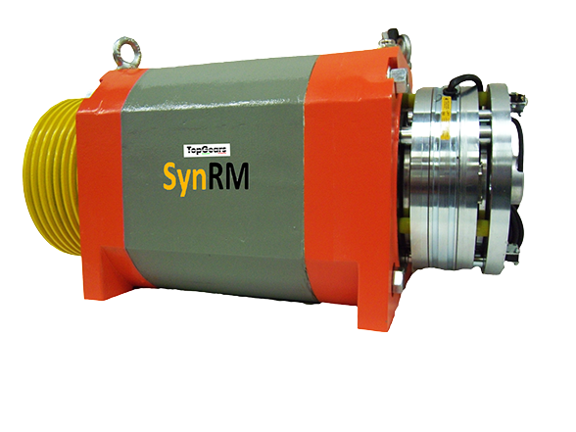
The Solution : ITG Project
Magnetic Reluctance (SynRM)
ITG has patented and developed a new lift system based on
a synchronous reluctant motor. This system brings important
enhancement over PM motor:
TOTAL ABSENCE OF PERMANENT MAGNETS (NEODYMIUM)
NO REQUIREMENT FOR ENCODER ( A SPECIALLY DESIGNED SOFTWARE IS REQUIRED )
DEFINITION OF LIFE SPAN AND DURABILITY

Slide 7
Customer Impact
Compared to PM technology:
40% more economical:
Increase in lifespan : Option to extend the guarantee
Extra low maintenance (MR technology is not subject to heat increase)
Both the dedicated software and the motor from one supplier, reducing product liability
Use of IoT (Nehushtan System)

Slide 8
NEHUSHTAN SYSTEM
ITG development of an APP platform (patent deposited)
Features :
Identifies the motor temperature;
Identifies the incorrect closing of the brake;
Identifies the presence of noise deriving from the traction machine
Identifies the type of noise thru harmonics analysis
Benefits :
Preventive maintenance of safety components (the brake) and other devices , allowing to reduce downtime for fault diagnosis and device control interventions
Cost reduction of time wastage of maintenance personnel as able to prepare the visit to the building in question, very specifcally

Slide 9
Energy framework
Elevator systems owner challenges :
The progressive aging of the existing elevator portfolio installed in Europe poses the problem of their cost effective renewal also in relation to the rules relating to their energy savings which, although lacking a harmonized standard in the definition phase, are already present thanks to VDI 4707 and ISO 25745
Solution:
Solution:
The ITG SynRM thanks to its high energy efficiency, low cost and lesser sensitivity to high operating temperatures due to low operation speed caused by the 1: 1 suspension of most of the existing plants, is better suited than any other current technology for the renovation of existing lifts

Slide 10
Magnetism toxicity issues
Magnetism affects everything including the human body. It may cause tiredness. If using a pacemaker, magnetism can be an hazard. The magnets that have been subjected to a surface treatment, as Neodymium magnets have, can cause skin irritation. In effect they are considered as toxic
Neodymium magnets are rare earth magnets used in PM gearless technology

Slide 11
PM vs SynRM technology

Slide 12
Toxic waste management
Since a magnet keeps at least a part of its magnetism, disposing of it with its strong magnetism can cause injury. To reduce the effect of magnetism it is advisable to wrap it several times before disposing of it. If disposed as industrial waste, nowadays it is disposed of in landfills. However, there is the need to reduce environmental contamination and conserve primary resources
In case of disposal as general household waste, it is mandatory to ask the local authorities for instructions to be followed for the disposal of hazardous and fragile materials.

Slide 13
Economic dependence issues
Neodymium is part of a group of 17 radioactive and toxic elements generally called rare earths. Currently 95% of these materials are extracted in China.
China has recently launched a platform for free trade in an attempt to maintain its monopoly on these RE minerals.
Monopoly of the industry by a non-democratic country like China is risky, although part of an international organization created for the purpose of overseeing the many trade agreements between Member States such as the World Trade Organization, as individual pricing decisions can bring nations to their knees

Slide 14
Economic dependence issues
In recent years, groups of experts convened by research institutes and governmental agencies such as the US Department of Energy, the European Commission have highlighted how the rare earth elements are fundamental for the new technologies used for the production of clean energy and electronic components both for large consumption and for specific military and aerospace applications, and how there is a high risk of interruptions in the supply of these materials due to the de facto monopoly of the industry of a non-democratic country like China

Slide 15
How SynRM works
In general, electric motors work on the principle of electrically created magnetic fields generating movement by using their force to act on a moveable part of the motor.
SynRM uses reluctance as the principal method of using the magnetic fields to create force. The natural magnetic field (and not electrically created ) finds the path of least magnetic resistance through the specially designed pattern in the rotor body.The created moving magnetic field then locks onto the patterned rotor generating the movement and force required to drive the lift. This is an entirely ferrous (steel) rotor with no rare earth permanent magnets

Slide 16
Market Opportunity
The global urbanisation; aging population; increasing safety needs; increasing demand for environmental friendly products, are some of the key factors which will drive the growth of this Industry and of the majority of its market segments.
As seen, elevators are majorly segmented in Gearless, Geared and Machine roomless (MRL). Gearless will be growing at 5%, MRL will be growing at 6% and Geared will register -2% drop by end of 2020.
Source : NOVONOUS Business Consulting Pvt. Ltd

Slide 17
SynRM clean energy Qualifier
Thanks to SynRM:
Eliminating the management of toxic waste;
Significant reduction in Kwh consumption;
Greater product durabililty;
EU Horizon 2020 program (biggest EU research & Innovation program) has qualified ITG SynRM as benefactor of the program
https://ec.europa.eu/programmes/horizon2020/en/tags/horizon-2020-research-and-innovation-programme

Slide 18
ITG SrL
THANKS YOU FOR YOUR ATTENTION
Mike Savic – Sales & Marketing Director
Andras Solyom – Sales Area Manager

